Slide 1
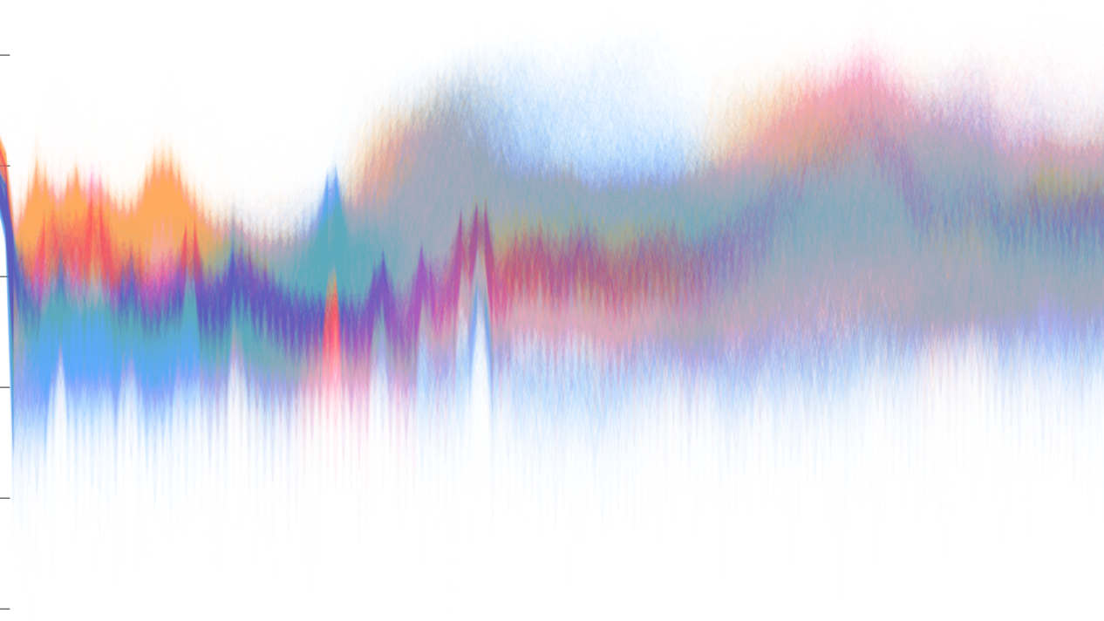
Speaker Recognition
ENGR518 Applied Machine Learning for Engineers :: Group 14
Juliya Johnson Shubham Mohapatra Kaimeng Du

Slide 2
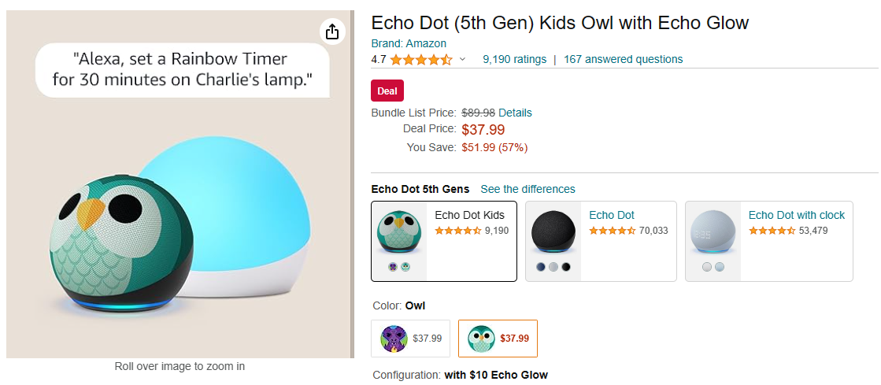
Introduction
Speaker Recognition on Smart Home Devices

Slide 3
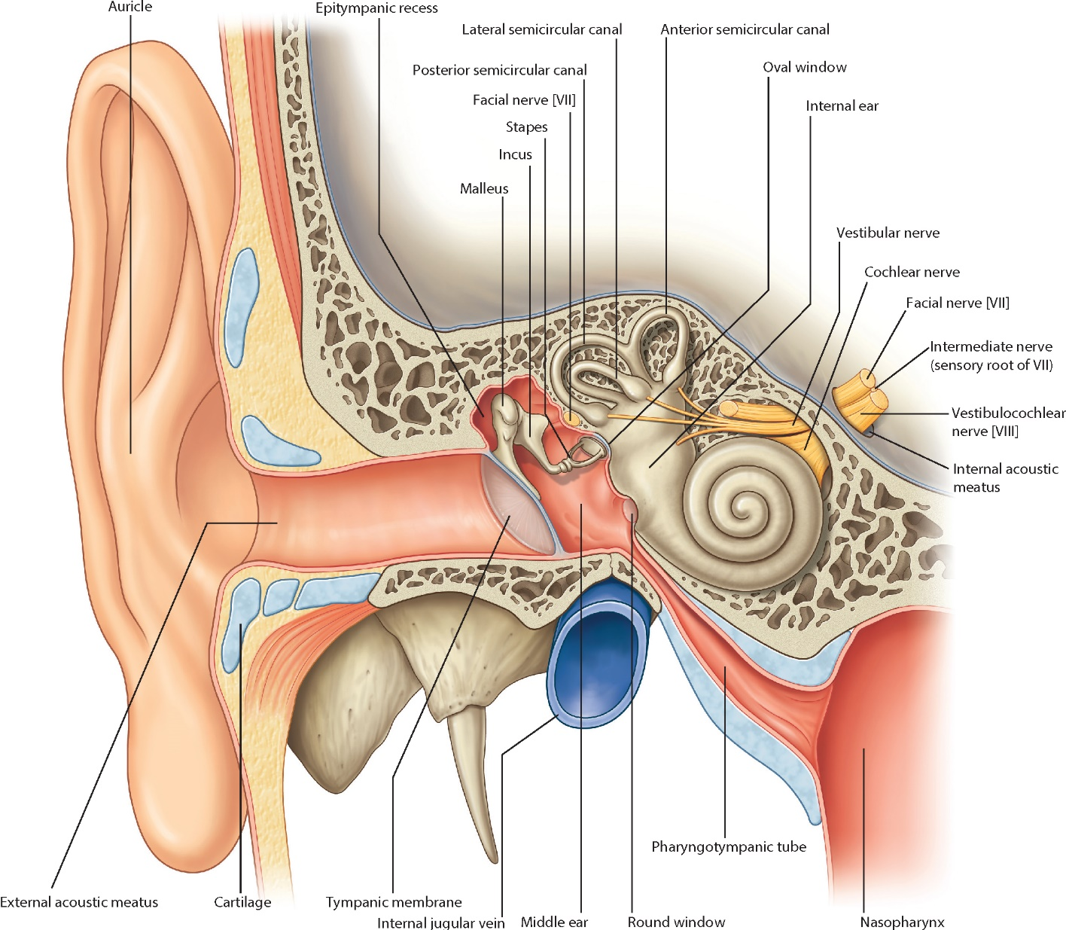
Introduction: Anatomy
Drake, Richard L., et al. Gray's Atlas of Anatomy E-Book. Elsevier Health Sciences, 2020.

Slide 4
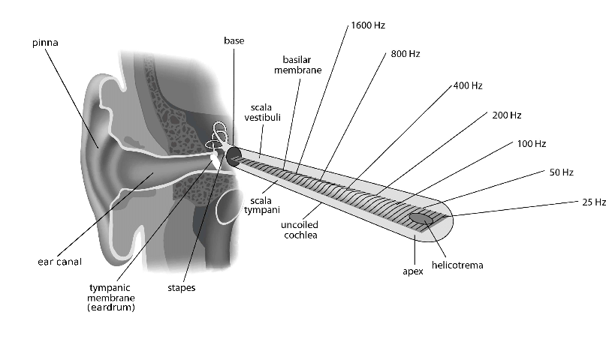
Introduction: Anatomy
Kern, Albert, et al. "Biophysical parameters modification could overcome essential hearing gaps." PLoS computational biology 4.8 (2008): e1000161.

Slide 5
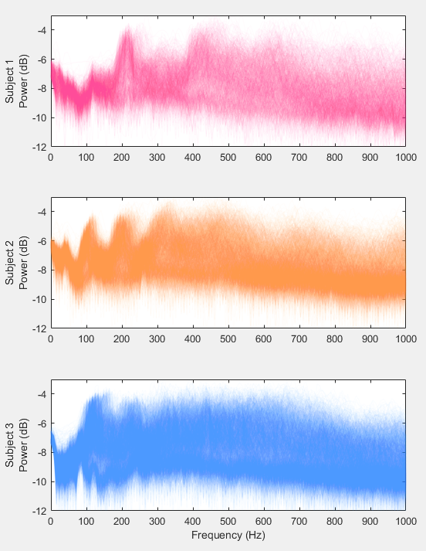
Data Prescreening
Short Time Fourier Transform
2048 Points moving window
512 Points overlap
~95% Accuracy in MATLAB Neural Network Patt. Recg. Toolbox

Slide 6

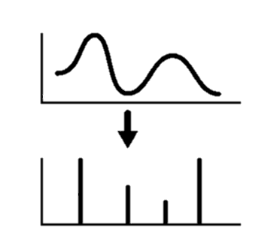

Project Flow
Data Acquisition
Training
Data
Class 1
Class 2
Class 3
Data Processing
Feature Extraction
Record Shuffling
Validation
Data
Testing
Data
Model
Evaluation

Slide 7
Model Architecture
1
3-Class Classifier
Logistic Regression
V0
x1
x2
V1
Argmax
Output
x3
V2
x150

Slide 8
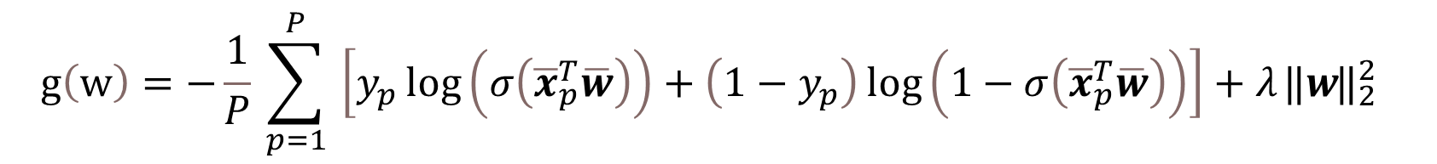
Model Training
Cost Function
$$g\left(w\right)=−\frac{1}{P}​\sum_{p=1}^{P}{​\left[y_{p}​\log\left(σ\left({\overline{x}​}_{p}^{T}\overline{w}\right)\right)+\left(1−y_{p}​\right)\log\left(1−σ\left({\overline{x}​}_{p}^{T}\overline{w}\right)\right)\right]+λ { ⃦w ⃦}_{2}^{2} }$$

Slide 9
Model Training
Performance ~95% Accuracy
Comparable to single layer neural network in MATLAB with 150 neurons in hidden layer, ~95% Accuracy

Slide 10
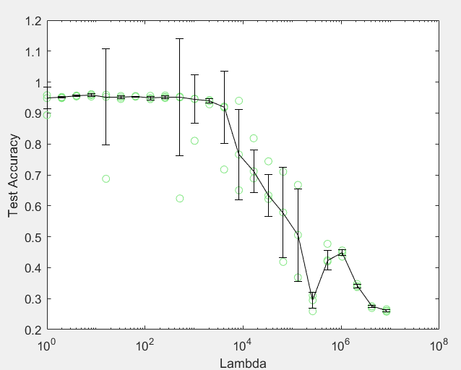
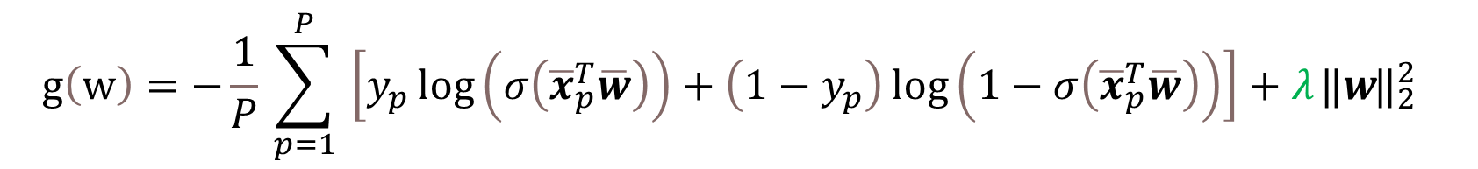
Regularization
$$g\left(w\right)=−\frac{1}{P}​\sum_{p=1}^{P}{​\left[y_{p}​\log\left(σ\left({\overline{x}​}_{p}^{T}\overline{w}\right)\right)+\left(1−y_{p}​\right)\log\left(1−σ\left({\overline{x}​}_{p}^{T}\overline{w}\right)\right)\right]+λ { ⃦w ⃦}_{2}^{2} }$$

Slide 11
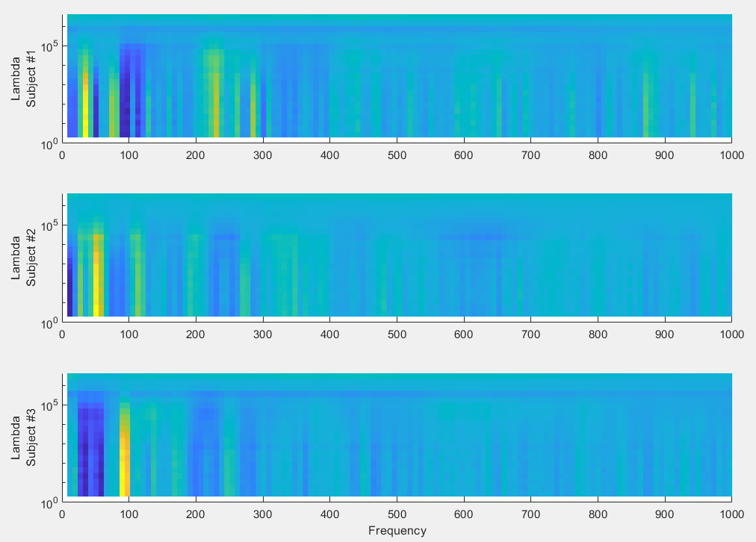
Feature Selection via Regularization

Slide 12
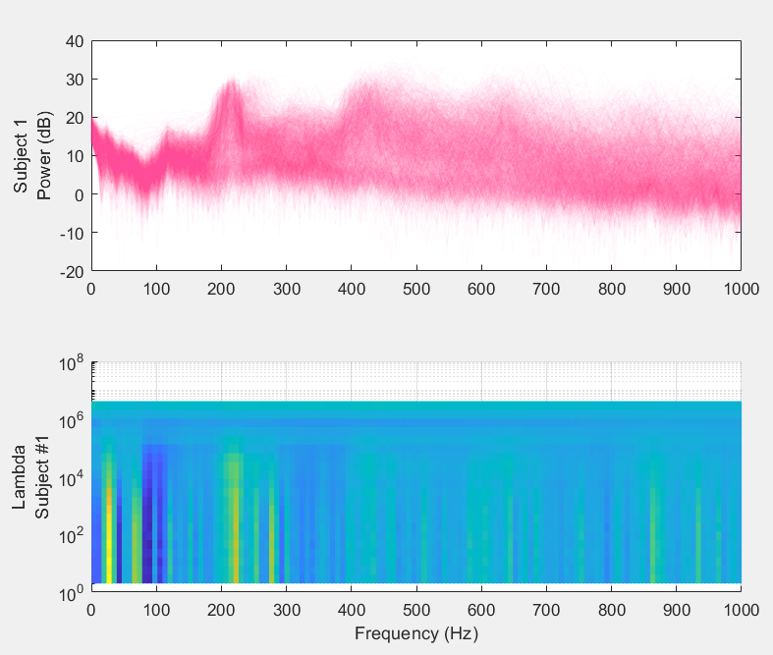
Feature Selection via Regularization
Features vs Weights

Slide 13
Feature Selection via Regularization
6 Frequency Bands
7.8Hz, 31Hz, 47Hz
94Hz, 109Hz, 226Hz
~82% Accuracy

Slide 14
Conclusion
Why Fourier Transform
3-Class Classifier
Feature Selection via Regularization
Further Improvements
Demo

